Slide 1


DEVSQUAD
Msunduzi Attendance System
A walkthrough and presentation of the development team, the hospice association and the attendance system

Slide 2
01
DevSquad Team Members
02
Msunduzi Hospice Association
Agenda
03
Demonstration
What we'll discuss today
04
Software Testing
05
Closing Remarks

Slide 3
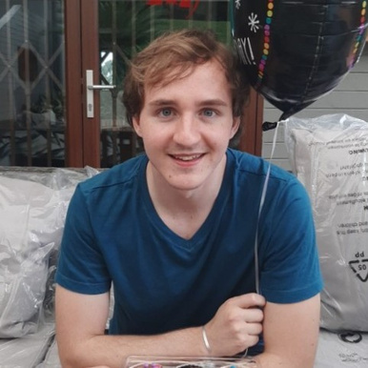


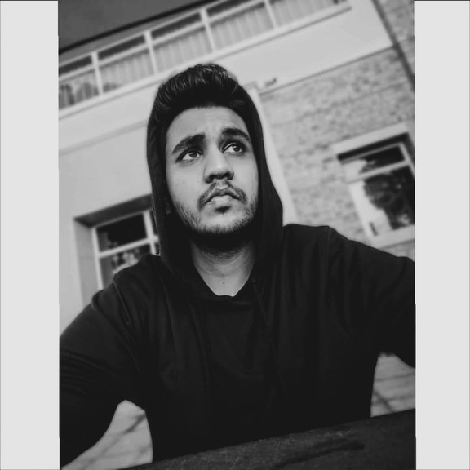

DevSquad Team
CHRISboik
Ellavarsi pillay
KAIISHKumar
YUSUF GOGA
PROJECT manager
DATABASEs/ secretary
System/ Graphic Designer
TESTER/ Documentation

Slide 4

MSUNDUZI HOSPICE ASSOCIATION
WE CARE BECAUSE YOU MATTER
Msunduzi Hospice provides quality home based care for patients who have a life limiting and/or life threatening illness. We are there for you when you need us.
01
About
LOCATION : pietermaritzburg
02
Msunduzi Staff
WEBSITE: www.hospicekzn.co.za
PHONE: 033-3441560
03
Business Goals

Slide 5
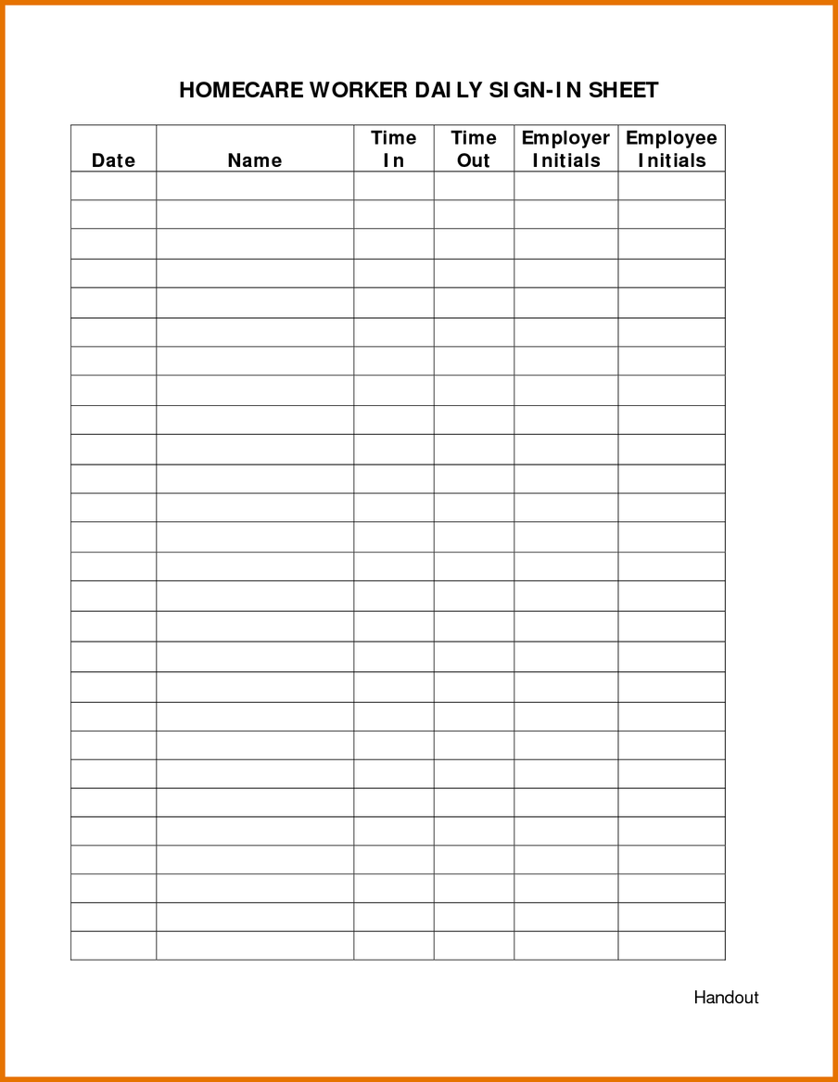
Current attendance system of Msunduzi Hospice
01
Risk of human error
02
Coronavirus
03
Time-consuming
04
Ineffective and outdated

Slide 6
Requirements from Msunduzi Hospice
01
02
03
04
Recording employee attendance in digital form
Application is be able to be used over a website
Storing employee details and attendance online
Employees should be given a unique identifier
05
06
07
08
Allow users to scan a QR code for sign in and out purposes
Allow flagging of employee records
Admin allowed to print out attendance records as pdf
Admin allowed to edit and delete records

Slide 7
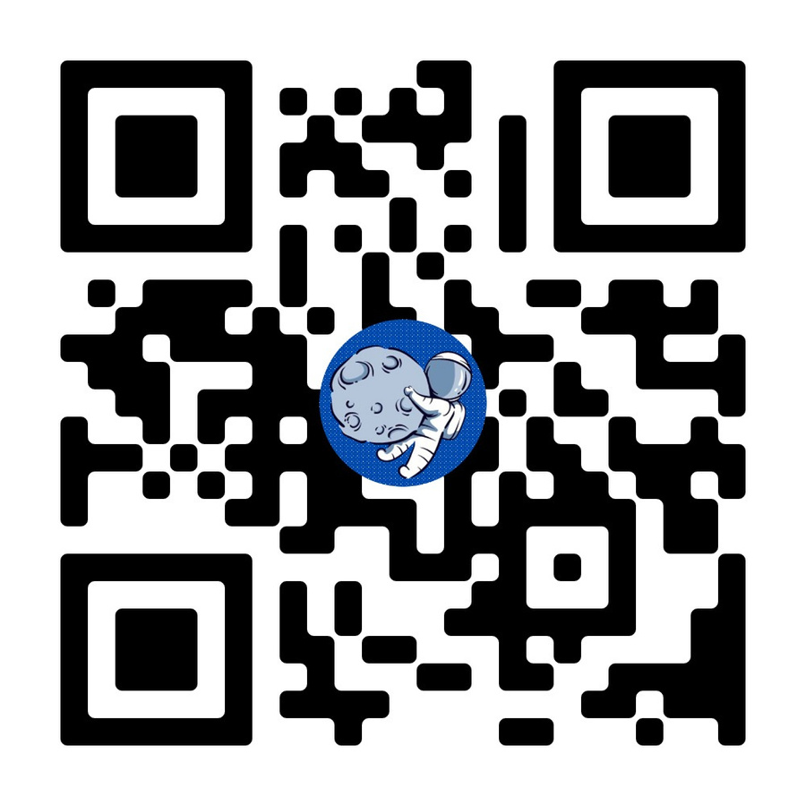


MSUNDUZI
ATTENDANCE SYSTEM
scan me

Slide 8




Sign In
01
Frictionless Sign In
02
Firebase Hosting
03
Generation of Unique Identifier

Slide 9
Clock In
01
Use of QR Code
02
Permissions required
03
Location and Camera Access

Slide 10
Error Handling
01
Invalid QR code
02
Permissions

Slide 11
User Settings
01
Frictionless change of account management
02
Unique Identifier visible to user and manager
03
Consent Required - Name, Surname, Picture

Slide 12
Clock Out
01
Clock Out Event
Information Saved - Time and Location
02
03
Roles - Flagging - Comments

Slide 13
Sign Out
01
Session clearing once signed out

Slide 14
Records Page

Slide 15
Users Page

Slide 16

Software's and Improvements
Angular
01
Single use QR codes
02
Analytics and Statistics
Bootstrap
03
Improve installation process of PWA

Slide 17
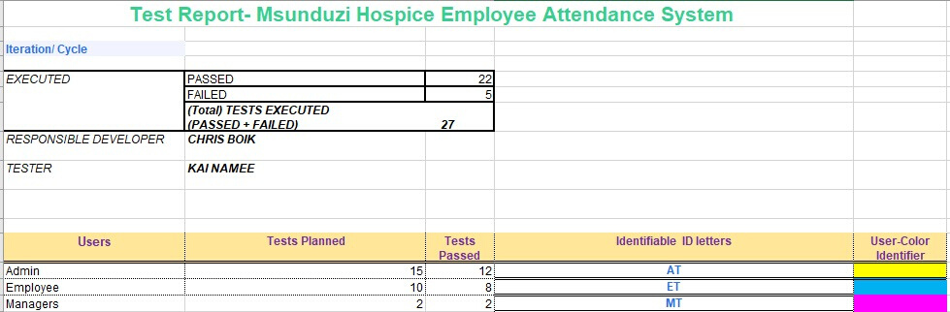
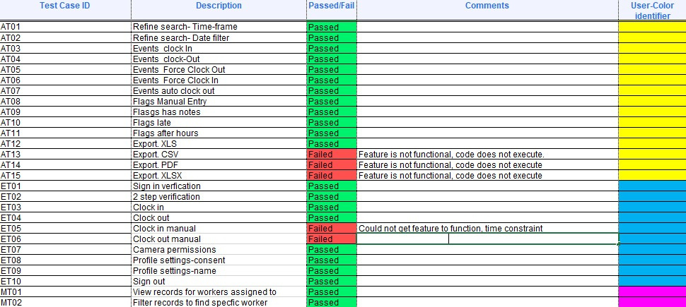
Debugging
Record and replay debugging
2. Post-mortem debugging
3. Remote debugging
Software Testing
Integrated Testing
2. End-to-end tests
3. Performance testing

Slide 18

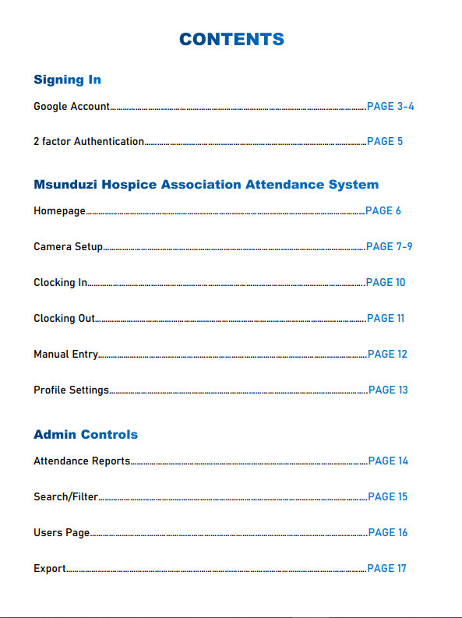
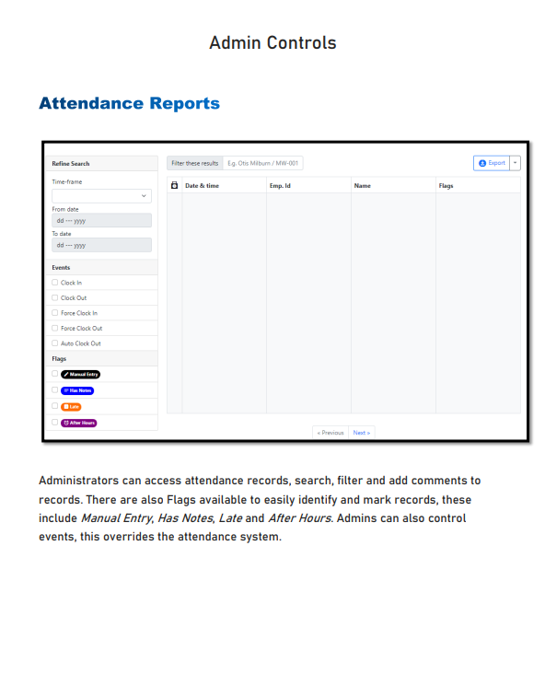
User Manual

Slide 19

Closing Remarks

Slide 20



"And the second is like unto it, Thou shalt love thy neighbour as thyself" Matthew 22:36-40
The greatest/ highest form of worship to God is serving humanity selflessly
"Help one another in acts of piety and righteousness"
Quran 5:2

Slide 21
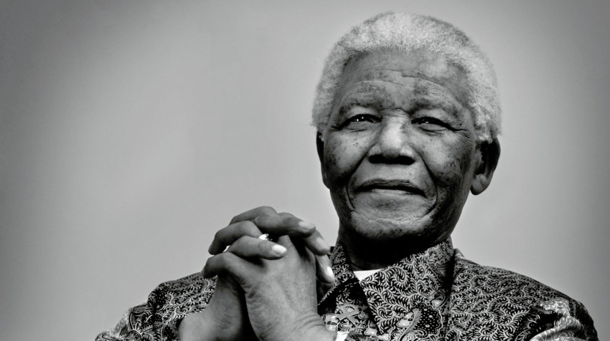
"THERE CAN BE NO GREATER GIFT THAN THAT OF GIVING ONE'S TIME AND ENEGERY TO HELP OTHERS WITHOUT EXPECTING ANYTHING IN RETURN"

